Slide 1
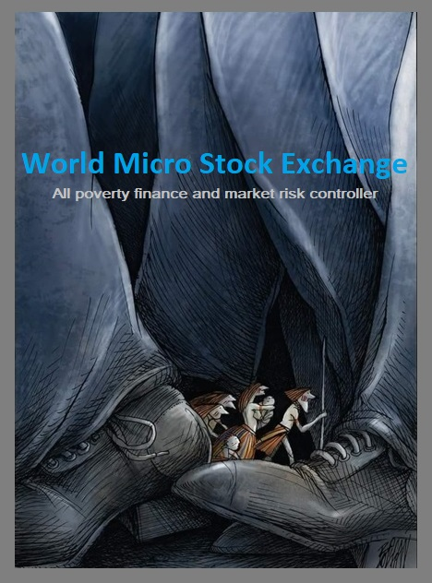
World Micro Stock Exchange is poverty free e-commerce Innovation for poor/financially weak sustainable development

Slide 2
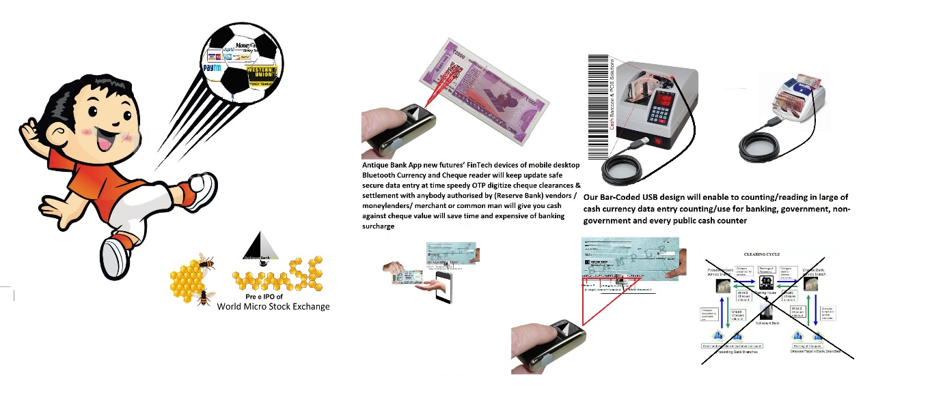
PROBLEM STATEMENT
We offer to every nation common masses will become micro shareholder and buy/sale or listing IPO (home made business or startup SME unit or we takeover fail business of government or non government disinvestment )any product or services hire under terms of micro shareholding proposition and pull out from any finance victimization self or family every banking/non-banking product or services providers company or every public/private cash counter have joint partner with us/merge their big data API of barcode reading by our Fintech devices of Bluetooth will find out all route of backup of ATM/Bank Robbery,(will block all cash robbed currency in cyber custody) nobody will assess or issue to next market or next handover accept
fake cash currency /Cheque /Aadhar card or any kind any nation government eKYC eID numbers also keep update record of consumers SMS OTP (MRP price will including micro share e-certificate credit value) all industry will following our term will sale or services providing under (Micro shareholding sale or listing IPO ) and government security exchange have to merge/allow us in their country will provide our office need and trial basis joint opening crowdfunding brokerages partnership MOU with big stock exchange to exchange (E2E) partnership under our big data crowdfunding of world micro stock exchange opening

Slide 3
SOLUTION
We opening new poverty free crowdfunding exchange of World Micro Stock Exchange a crowdfunding big data management and micro shareholding value proposition exchange will reduce all kind risk of poverty, finance and market volatility were every common masses/all industry and government will tie-up for merge/equity partnership daily buy( an investor) sell or listing IPO product & services applying under value proposition of micro shareholding will generate daily profit sharing portfolios value for all our exchange end user extra income sources all industry will free from all burden of sale & marketing and un fulfil IPO in listed in bid stock exchange will get second option to fulfil by our worlds crowdfunding applying at our Micro Stock Exchange also all NGO temple trust donation will convert in to crowdfunding public fund investment policy applying to all government or private bad bank loan or recovery Mafia asset, government disinvestment will get new way bid applying IPO we will giving high bid auction and purchase and takeover all any kind despite asset

Slide 4
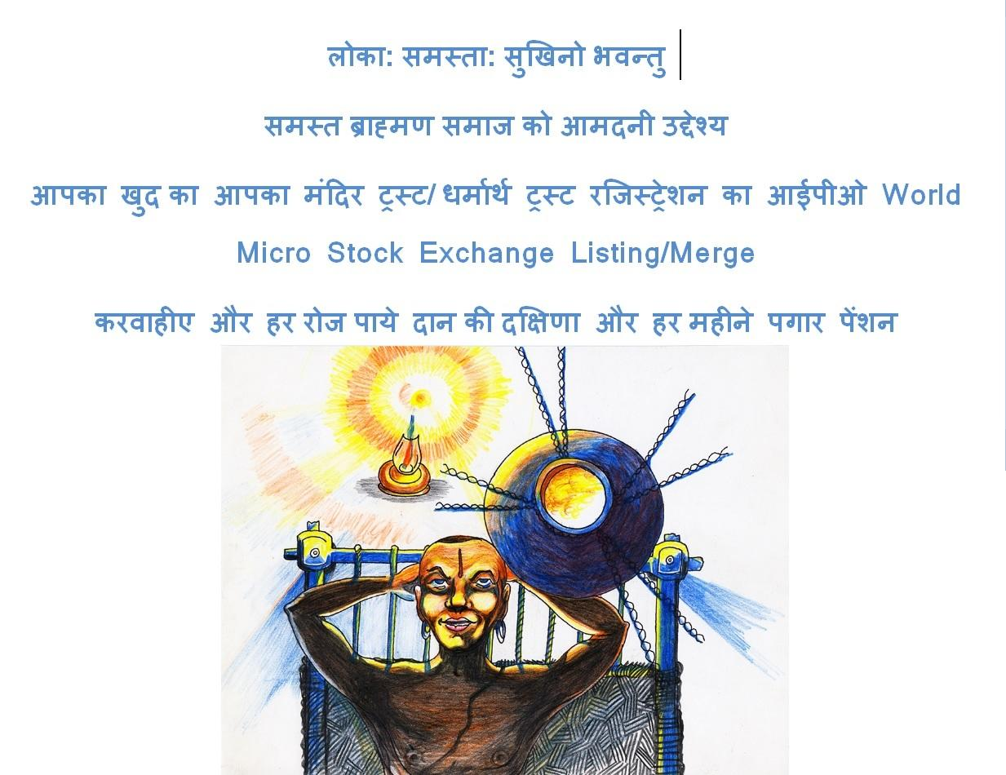

Slide 5
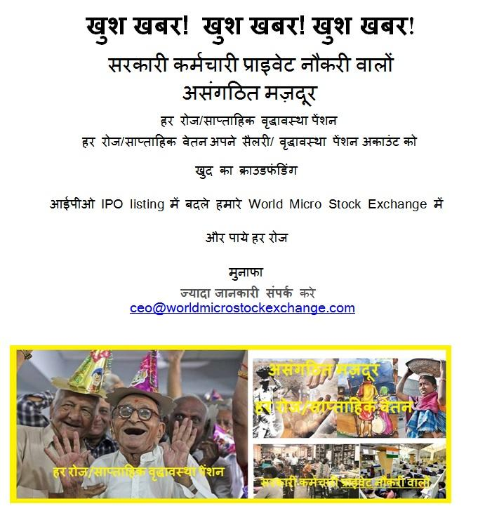

Slide 6
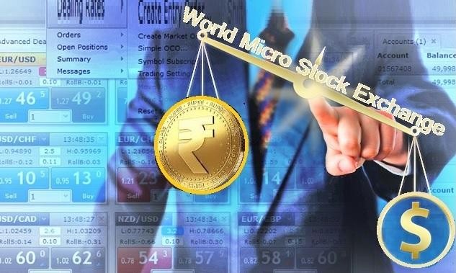

Slide 7
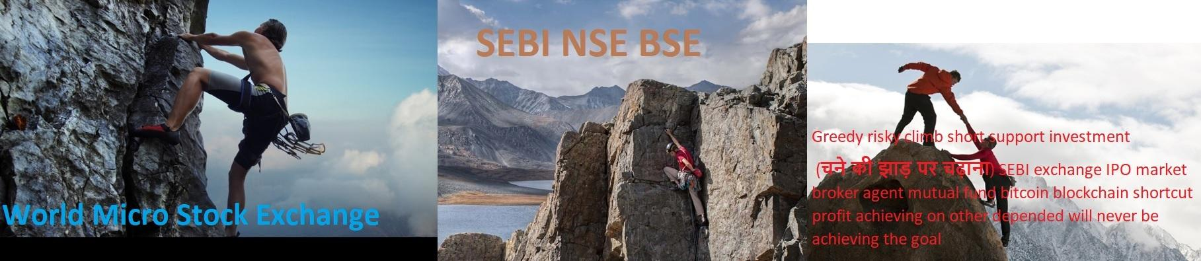
Dare to Alone close eye climb without support any instrument or fear of market or no need invest expertise or advice only adopt our e-direction of buy(as Investor ) sell or listing /investing in our world’s crowdfunding managements to following /applying of big data of micro shareholding value proposition exchange at World Micro Stock Exchange and win achieving goal any angle kick Slow climbed with orally broker market gossip advice support long/short terms investment risky market volatile and fewer portfolios value and mind confused achieve to voluntary period goal Greedy risky climb support in short period investment (चने की झाड़ पर चढ़ाना) SEBI exchange IPO market broker agent mutual fund bitcoin blockchain shortcut profit achieving on other depended will never be achieving the goal

Slide 8

Today Gold /Big Stock have needed big capital or bank loan burden to purchase and invest short/long term will no guarantee fixed income or high return and fear of fewer market volatile and market players risk V/S World Micro Stock Exchange (Platinum chip) no need capital only daily you’re buying in term of our World Micro Stock Exchange listed company, SME or homemade product or services applying will convert in yours position owner of micro shareholding portfolio, and start trading/ investment listing earning in multiple high returns within hours or month and pull out self or your family any kind finance burden

Slide 9
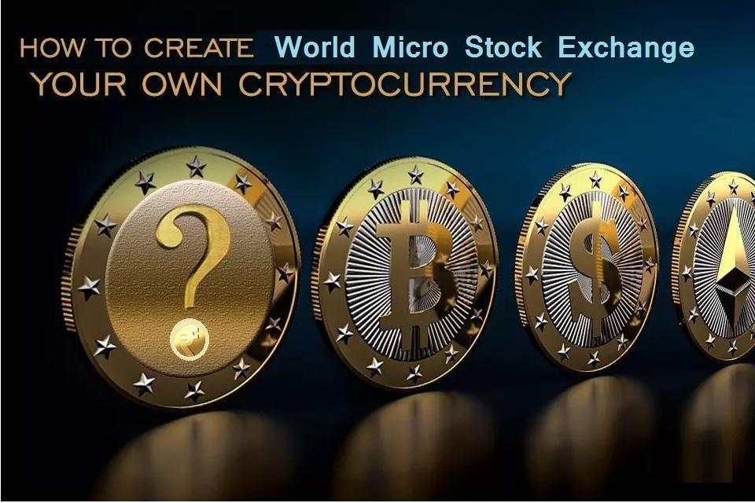
How can Indian Rupees will tuff/beat to world cryptocurrency and increasing value in world’s forex that our micro shareholding value proposition World Micro Stock Exchange crowdfunding management and human capital investment will collapse to all future big stock market by world's gamble players also defocus future factor of gold, dollar, fuel, and cryptocurrency investment

Slide 10

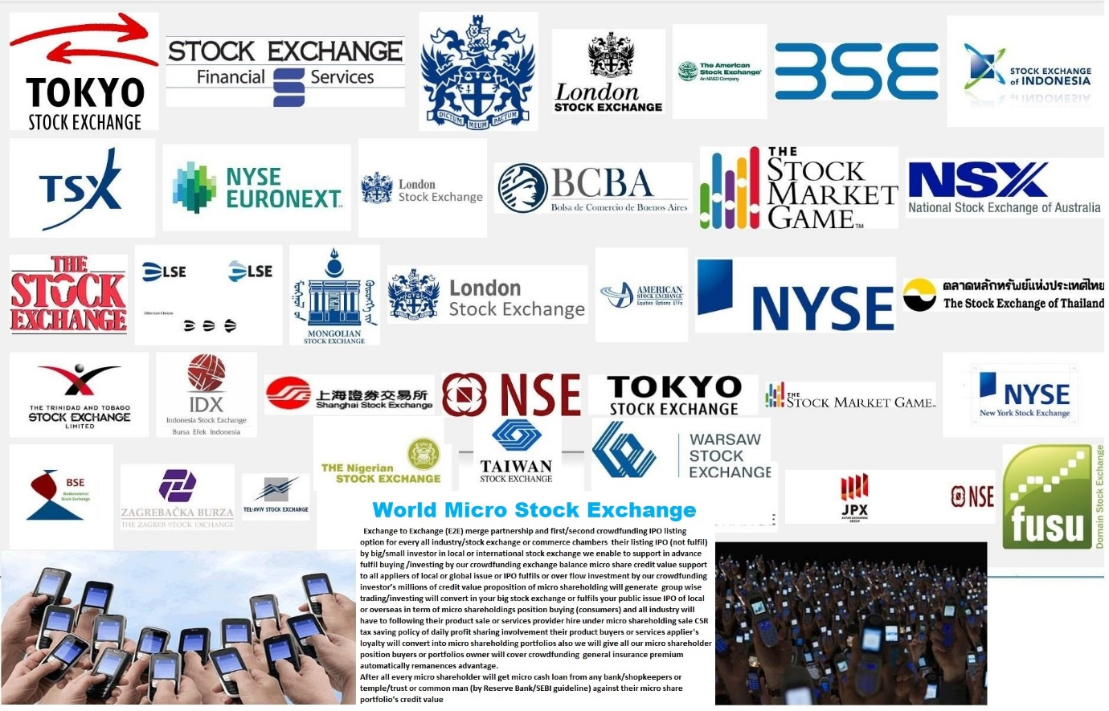


ADDITIONAL SUPPORT DOCUMENTS

Slide 11
THANK YOU Pradeep Kumar Gohil CEO/Founder World Micro Stock Exchange ceo@worldmicrostockexchanmge.com Mo:9833373441,8369096330

